Slide 1

TAKAFUL – FASTEST TOOL FOR ECONOMIC GROWTH AND FINANCIAL INCLUSSION
BY
JOOF MOMODOU MUSA
GLOBAL TAKAFUL & RE TAKAFUL FORUM

Slide 2



My Foundation
GLOBAL TAKAFUL & RE TAKAFUL FORUM

Slide 3
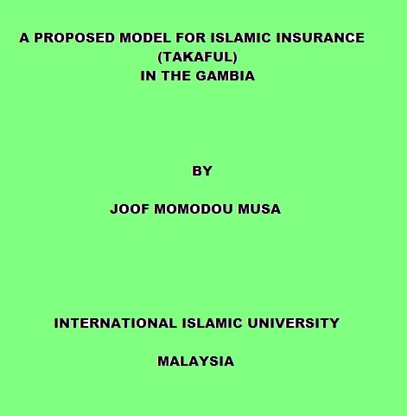
My Thesis on Takaful

Slide 4
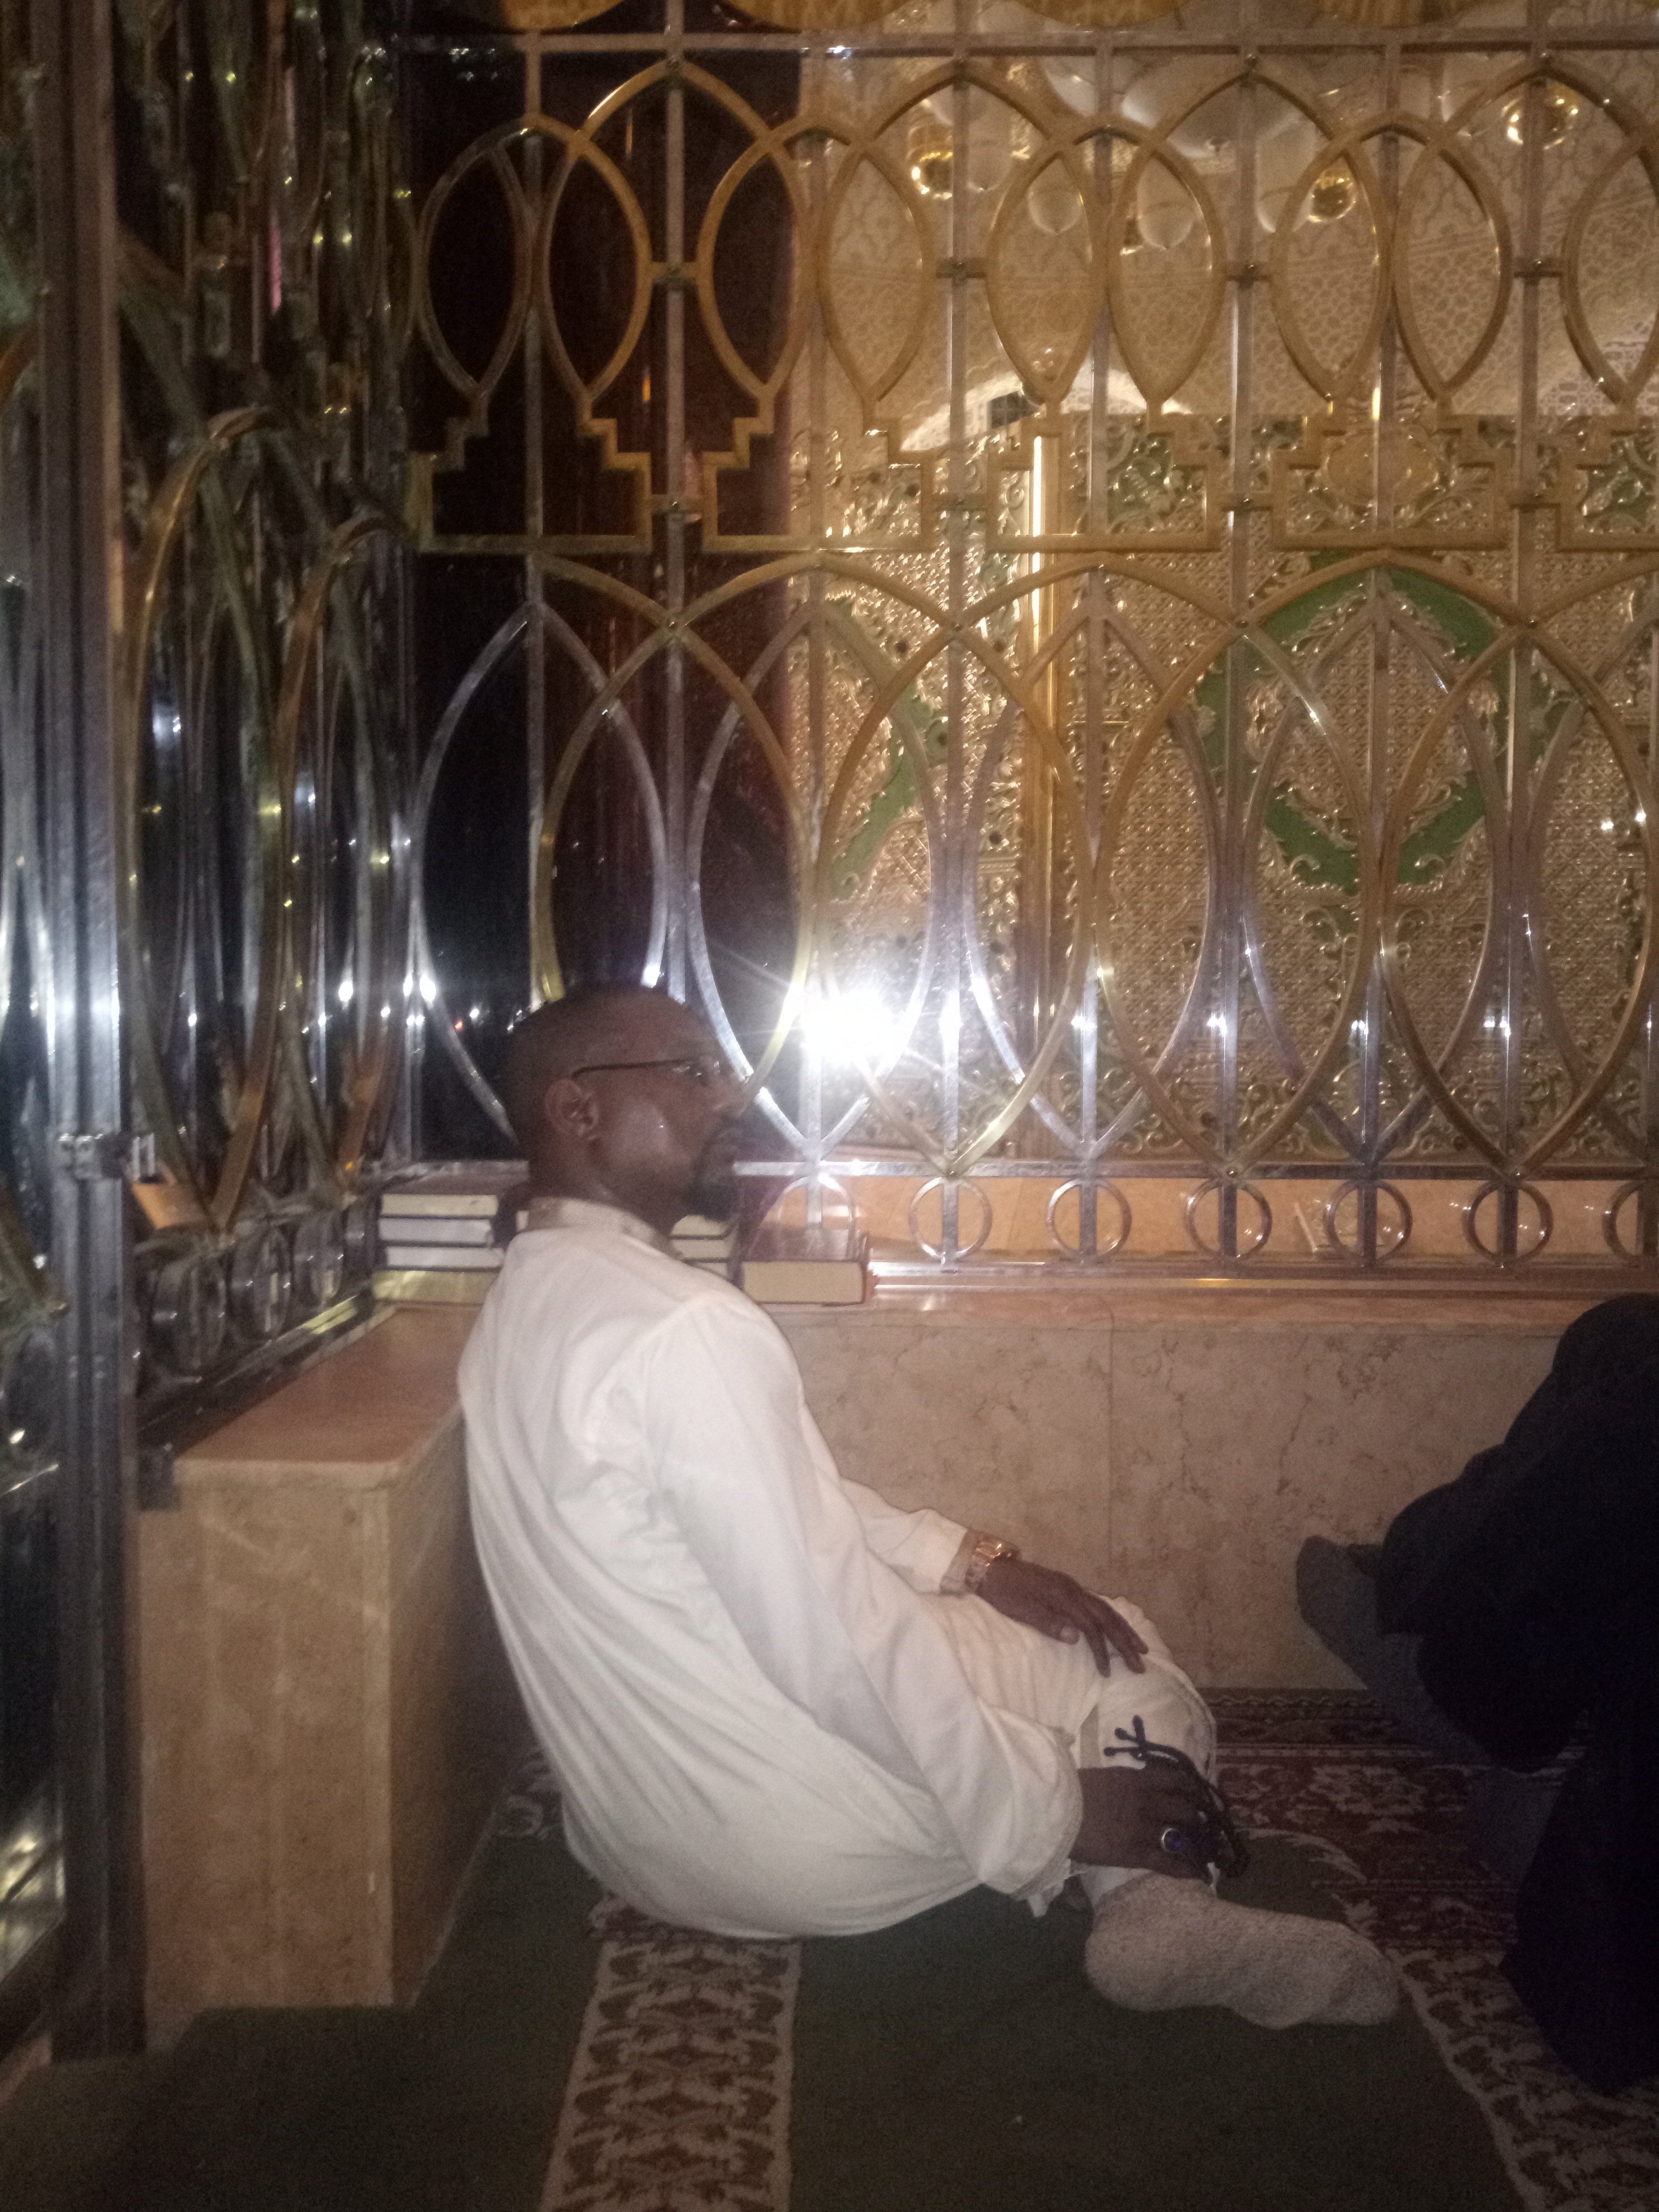
PRESENTATION FLOW:
SLIDES 1 - 7 Analyses Conventional Insurance
SLIDES 8 - 13 Introduces to TAKAFUL
SLIDES 14 - 15 APPRECIATES MICRO TAKAFUL
JERREH JEFF – SEREIGN TOUBA NGORR YALLA MOURTADA JARAWLACK

Slide 5
Islamic View of Insurance
The Concept of Insurance
Pooling of common resources to help the needy – the ‘fortunate many’ helping the ‘unfortunate few’.
Therefore the concept embodies the element of :-
Joint help
Solidarity
Cooperation.
Conceptually insurance is not contrary to the rules of Islam.
But for their Principles and Practice (Conventional Insurance)

Slide 6
Presence of Gharar
Contracts Not in line with Shariah
Selling/Buying of Goods or services that do not exist.
Selling/Buying of Goods or services that exist but unable to be delivered to buyer.
Selling/Buying of Goods or services that exist and can be delivered to the buyer but not able to determine/know of its modes, quantum, exact timing, source, etc.
Joof Momodou Musa GLOBAL TAKAFUL & RE TAKAFUL FORUM 18.03.2021

Slide 7
Contracts Not in line with Shariah
Gharar in Insurance
Due to its Buy-Sell transaction.
Subject matter uncertain.
For how long premium is to be paid.
When would claim occur and what would be its quantum.
Source of payment not known.
Lopsidedness nature resulting in ‘injury’ or unjust loss to one side only.

Slide 8
Contracts Not in line with Shariah
Maisir in Insurance
Policyholder hoping to receive ‘huge’ proceed from claims against ‘small’ payment of premium.
Chances policyholder loosing all premium paid.
Like a chance transaction.
Profit or loss of insurer depends on the chance of misfortune happening or otherwise (underwriting result)

Slide 9

The presence of Riba in Practice
CONTRACT NOT IN LINE WITH SHARIAH
Investment of premium in riba-based (interest) avenues.
Interest on policy loan.
Refund of premium not on pro-rata basis.
Guaranteed return.

Slide 10
As defined in Section 2 Takaful Act 1984: (Malaysia)
WHAT IS TAKAFUL?
“a scheme based on brotherhood, solidarity and mutual assistance which provides for mutual financial aid and assistance to the participants in case of need whereby the participants mutually agree to contribute for that purpose.”
Momodou Musa Joof GLOBAL TAKAFUL & RE TAKAFUL FORUM 18.03.2021

Slide 11
Meaning of Takaful by Zubair Mungal - Alhuda
Takaful comes from the Arabic root-word ‘kafala’ — guarantee.
“Takaful” is the Sharia Compliant brand name for the Islamic alternative to conventional insurance. Its based on the principle of Ta’awan or mutual assistance.

Slide 12
THE SYSTEM OF TAKAFUL OR SHARIAH COMPLIANT INSURANCE
Gharar
Gharar
Maisir
Maisir
Riba
Riba
Takaful
Tabarru’ filters out all the objectionable elements from the insurance contract.
→ Takaful = Insurance Minus The Objectionable Elements

Slide 13
TAKAFUL AS TOOL FOR ECONOMIC GROWTH
Employment
Creation of Employment opportunities
Tax Revenue
More Tax Revenue from the Insurance Industry

Slide 14
TAKAFUL AS TOOL FOR ECONOMIC GROWTH
Comprehensive Risk Insurance
Insuring the uninsured insurable risk
Increased Economic Activity
Successful Economies are backed by vibrant Insurance industries
Increased Investment with more participants in Insurance
More confidence for new economic ventures

Slide 15
ENFORCED TRANSPARENCY AND FAIRNES IN TAKAFUL GIVES COMFORT TO PARTICIPANTS
1
Investors
2
Statutory Capital / Registration
3
Board of Directors
4
Shariah Advisory Board
5
AUDITORS
REGULATORS
OPRATOR

Slide 16
MICRO-TAKAFUL AS A TOOL FOR FINANCIAL INCLUSSION
Micro-insurance :
“Generally, micro-insurance is viewed just like other normal insurance on small scale for low-income people”
MicroTakaful :
“A mechanism to provide Shariah-based protection to the blue collared, under-privileged individuals at an affordable cost”.

Slide 17
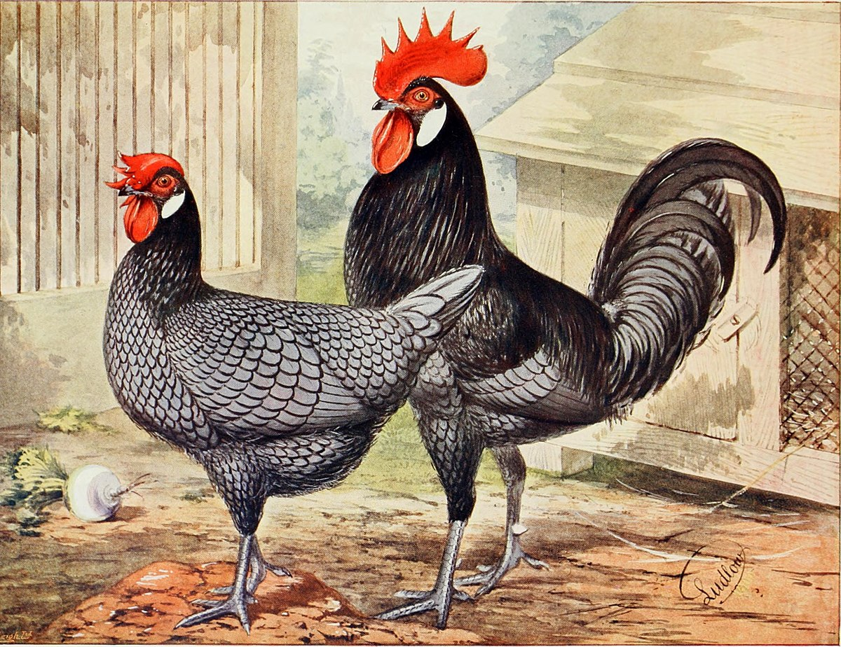
MICRO-TAKAFUL AS A TOOL FOR FINANCIAL INCLUSSION
WE CAN DESIGN MICRO-TAKAFUL PRODUCTS TO COVER HEALTH FOR TEACHERS AND STUDENTS
WE CAN DESIGN MICRO-TAKAFUL PRODUCTS TO GROUP PERSONAL ACCIDENT FOR STUDENTS
MICRO-TAKAFUL PRODUCTS COULD BE DESIGNED TO COVER CREDIT
MICRO-TAKAFUL COULD ALSO BE DESIGNED TO COVER CROPS AND POULTRY.

Slide 18

MOMODOU MUSA JOOF
MANAGING DIRECTOR/CEO
WEST AFRICA TAKAFUL, THE GAMBIA
Email: momodoum@westafricatakaful.com
H/P +220 7344439

